Slide 1


The Comprehensive Geriatric Assessment and Geriatric Syndromes
Professor of the Department internal diseases Liskova Yu.V.

Slide 2
Objectives
Describe a Comprehensive Geriatric Assessment (CGA) and its importance to geriatric care.
Discuss the components of a CGA through case studies.
Review common geriatric syndromes including diagnosis and management.

Slide 3
Welcome to Your Future
Why Geriatrics?
  Aging- If you’re lucky, you will do it!
  As a healthcare professional, you will have to practice it!
  As a young person, you have to respect it!
  As a contributor, you should want to make a difference!

Slide 4
Welcome to Your Future!
Projection on Future Number of Geriatricians in the United States. May 2011
Year | No. of Geriatricians | Population 75 and older | Population 75 and older/10,000 | Geriatricians/10,000 75 and older
2000 | 7,762 | 16,600,767 | 1,660 | 4.7
2010 | 6,756 | 18,766,113 | 1,877 | 3.6
2020 | 7,560 | 22,492,284 | 2,249 | 3.4
2030 | 8,363 | 33,307,590 | 3,331 | 2.5
2040 | 7,380 | 44,343,168 | 4,434 | 1.7
2050 | 7,264 | 48,434,336 | 4,843 | 1.5

Slide 5
Comprehensive Geriatric Assessment
Cornerstone of Geriatric Medicine
What sets us apart from other disciplines
Patients and families appreciate this approach to patient care
How patient care should be done

Slide 6
Comprehensive Geriatric Assessment
Process intended to determine a patient’s medical, psychosocial, and functional capabilities and limitations
Goal is to develop an overall plan for treatment and long-term follow-up
Implemented by a highly-trained team

Slide 7

Geriatric Team
Geriatrician
Geriatric Nurse Practitioner
Social Worker
Clinical Nurse Case Manager
Therapists (PT/OT)
Other Geriatric Specialists

Slide 8
Comprehensive Geriatric Assessment
Screen for Depression: Geriatric Depression Scale (GDS)
Screen for Cognition: MMSE, SLUMS (slide 9), Mini-Cog
Functional Status: Activities of Daily Living (ADLs) and Instrumental Activities of Daily Living (IADLs) (see slide 10)
Mobility Status: Get Up and Go Test (see slide 11)
Nutritional Assessment: Mini Nutritional Assessment
Medication Review
Comprehensive History and Physical Exam
Notes:
MMSE-Mini-Mental Status Examination
SLUMS-St. Louis University Mental Status examination
Mini-Cog-A screening tool for early cognitive decline

Slide 9
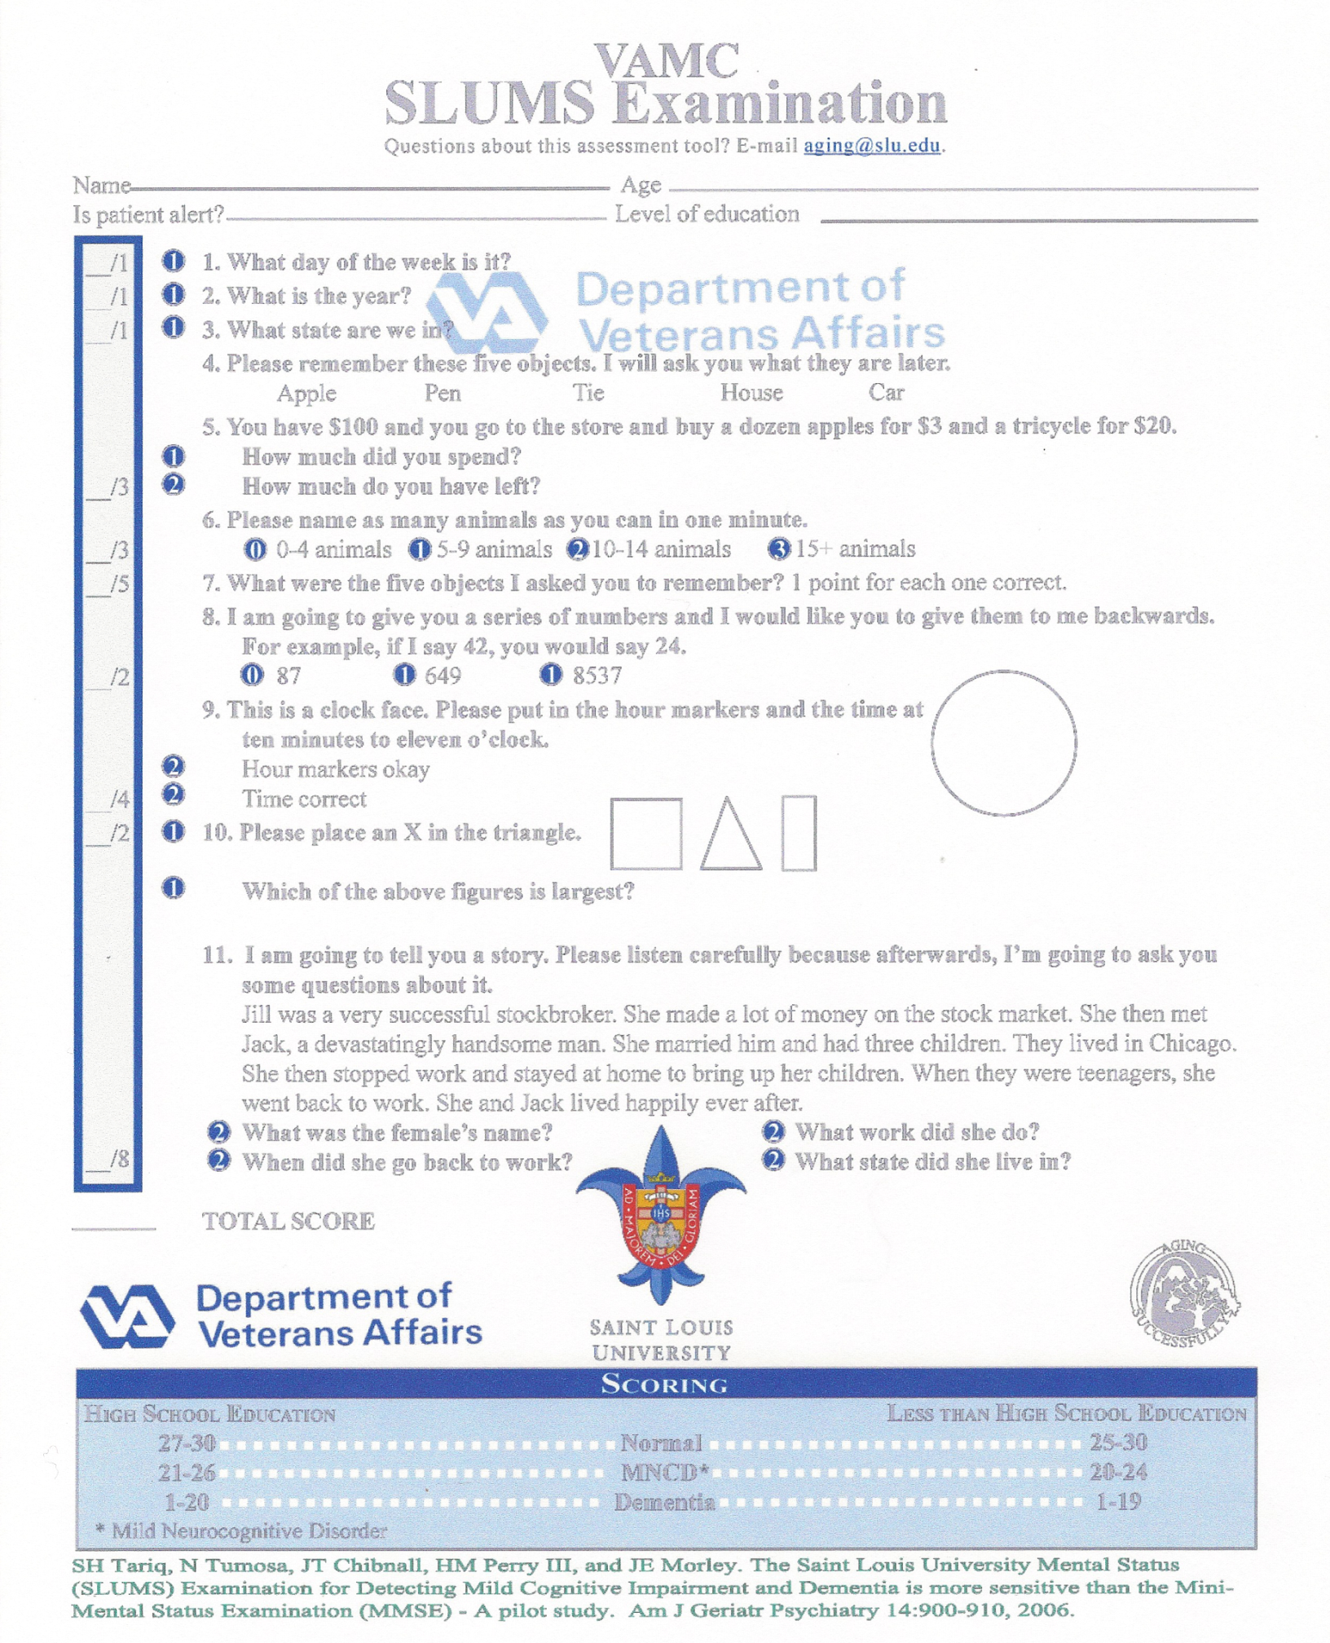

Slide 10
Functional Status
ADLs
IADLs
Bathing
Dressing
Toileting
Transfer
Continence
Feeding
Independent
Assistance
Dependent
Telephone
Traveling
Shopping
Preparing meals
Housework
Repairs
Laundry
Medication
Money

Slide 11
Get Up and Go Test
Ask the patient to perform the following series of maneuvers:
Sit comfortably in a straight-backed chair.
Rise from the chair.
Stand still momentarily.
Walk a short distance (approximately 3 meters).
Turn around.
Walk back to the chair.
Turn around.
Sit down in the chair.
Observe the patient's movements for any deviation from a confident, normal performance. Use the following scale:
  1 = Normal
  2 = Very slightly abnormal
  3 = Mildly abnormal
  4 = Moderately abnormal
  5 = Severely abnormal
A patient with a score of 3 or more on the Get-up and Go is at risk of falling.

Slide 12
Assess Nutritional Status
Mini Nutritional Assessment
Barriers to adequate intake
    Cost
    Ill-fitting dentures
    Presentation of food
    Social Isolation

Slide 13
Medication Review
Prescribed and OTC meds
Drug-Drug Interactions
Safety in Elderly
Regimen

Slide 14
Traditional Use of Geriatric Assessment
Primary Care-Geriatrician is not just about consultation. They are primary care!
Geriatric Consultation
Evaluate the need for long-term care or for transitions of care
Multiple applications of Geriatric Assessment to aid in the medical decision making for elders

Slide 15
Comprehensive Geriatric Assessment
Has rendered successful outcomes in improving function, allowing patients to remain at home and decreasing hospital readmissions
CGA is an invaluable tool in assessing the geriatric patient and can be applied in multiple settings
Notes:
Has been documented in the literature.

Slide 16

CGA and the Cancer Patient
Case of Mrs. T.L.
84 year old African American Female
with history of Depression, Moderate
Alzheimer’s Disease, Hypertension,
Diabetes Mellitus and Hyperlipidemia
presented to clinic in July 2009 to establish care.
Comprehensive Geriatric Assessment at onset:
    GDS: 8/15
    MMSE: 18/30
    ADLs: dependent for bathing
    IADLs: dependent for shopping, transportation, finances, housekeeping, and laundry
    Get Up and Go: normal

Slide 17
CGA and the Cancer Patient
Basic labs done- Serum Alanine Aminotransferase (ALT): 55; Serum Aspartate Aminotransferase (AST): 43
Physical Exam normal
In August, the patient’s daughter called and said that her mom’s color had turned yellow!
Patient seen next business day and work-up pursued including imaging, labs.
CT scan done showed a small pancreatic mass with obstruction.
Biopsy consistent with pancreatic cancer and a biliary stent was placed.

Slide 18
CGA and the Cancer Patient
Had a family meeting, findings were presented and recommendations made.
Recommended hospice for symptom management and end-of-life care.
Surgery team recommended surgical resection and referred patient to Oncology.
Oncology recommended chemotherapy and more aggressive treatment.
Patient and family both agreed on hospice and comfort care. The patient had a wonderful Thanksgiving holiday surrounded by family and friends and passed away the next day.

Slide 19
Eastern Cooperative Oncology Group (ECOG)
Grade 0 — fully active, able to carry on all pre-disease performance without restriction
Grade 1 — Restricted in physically strenuous activity, but ambulatory and able to carry out work of a light or sedentary nature, i.e. light housework, office work
Grade 2 — Ambulatory and capable of all self-care, but unable to carry-out any work activities. Up and about >50% of waking hours
Grade 3 — Capable of only limited self-care, confined to bed or chair >50% of waking hours
Grade 4 — Completely disabled. Cannot carry-out any self-care. Totally confined to bed or chair.
Grade 5 — Dead

Slide 20

Eastern Cooperative Oncology Group (ECOG)
% | % | Ambulation | Activity Level Evidence of disease | Self Care | Intake | Level of Consciousness
100 | 100 | Full | Normal No disease | Full | Normal | Full
90 | 90 | Full | Normal Some disease | Full | Normal | Full
80 | 80 | Full | Normal with effort Some disease | Full | Normal or reduced | Full
70 | 70 | Reduced | Can’t do normal job or work Some disease | Full | As above | Full
60 | 60 | Reduced | Can’t do hobbies or housework Significant disease | Occasional assistance needed | As above | Full or confusion
50 | 50 | Mainly sit and lie | Can’t do any work Extensive disease | Considerable assistance needed | As above | Full or confusion
40 | 40 | Mainly in bed | As above | Mainly Assistance | As above | Full or drowsy or confusion
30 | 30 | Bedbound | As above | Total Care | Reduced | As above
20 | 20 | Bedbound | As above | As above | Minimal | As above
10 | 10 | Bedbound | As above | As above | Mouth care only | Drowsy or coma
0 | 0 | Death | - | - | - | -

Slide 21
CGA and the Cancer Patient
Oncologists and Geriatricians have not always worked together!
Widely known and studied that functional status is most important predictor of mortality.
Studies of CGA and geriatric cancer patients demonstrated that functional status predicts survival, chemotoxicity, and post operation morbidity and mortality.
Use of the CGA can further enhance the information obtained or interpreted from Karnofsky or ECOG scales.

Slide 22

CGA and the Surgical Patient
The Case of Mrs. B.H.
Reason For Consult: “Delirium”
80- year-old female admitted to General Surgery Team

Slide 23
The Case of Mrs. B.H., Medical History
Past Medical History
Diabetes Mellitus
Hypertension
Coronary Artery Disease
Myocardial Infarction S/P Coronary Artery Bypass Graft
Congestive Heart Failure
Breast Cancer
Depression
Osteoporosis

Slide 24
The Case of Mrs. B.H., Medical History (continued)
Patient was noted to have left breast mass found in September 2008 and was referred to Oncology.
Patient was enrolled in trial of Dasatinib, and one week after initiation of therapy, patient had Myocardial Infarction (MI) and a Coronary Artery Bypass Graft performed at a community hospital.
Daughter attributed the chemotherapy to the MI and decided to pursue no further chemotherapy.

Slide 25
The Case of Mrs. B.H., Medical History (continued)
The patient received care at other sites until May 2009, where she presented to the hospital Oncology Clinic with a 7cm x 7cm inflammatory lesion with central nipple ulceration and bloody discharge of the left breast.
The patient was then referred to the General Surgery clinic for a palliative Modified Radical Mastectomy (MRM) with split thickness skin graft to be performed.
The daughter desired no further chemotherapy.
Her Oncologist stated “I have no options for her.”

Slide 26
The Case of Mrs. B.H., Medical History (continued)
Patient seen by Cardiology for clearance.
Patient seen by Geriatrics for clearance.
Geriatric Assessment:
    GDS: 2/15
    MMSE- unable to complete due to visual impairment.
    ADLs: dependent for bathing only
    IADLs: dependent for preparing food, taking medications, shopping, transportation, finances, laundry, and housekeeping
    Get Up and Go: abnormal; ambulates at home by wheelchair
Patient deemed intermediate surgical risk.

Slide 27
The Case of Mrs. B.H., Hospital Course
Patient underwent MRM with split thickness skin graft on
August 3, 2009, and then admitted to the General Surgery Team.
Cardiology was consulted to manage blood pressure issues.
On hospital day two, Geriatrics was consulted for evaluation
of delirium.

Slide 28
The Case of Mrs. B.H., Hospital Course (continued)
Geriatric Assessment: Unable to perform MMSE and GDS due to delirium; Memorial Delirium Assessment Scale: 23/30; ADLs — some assistance required and dependent for IADLs. Family support provided by her daughter.
Patient was diagnosed with Mixed Type Delirium and started on Haldol, which was titrated to achieve effect.
Geriatrics assumed primary care when her surgical issues
were stable.
Patient’s delirium was resolving and she was then transferred
to a geriatric patient care unit in a neighboring hospital.

Slide 29
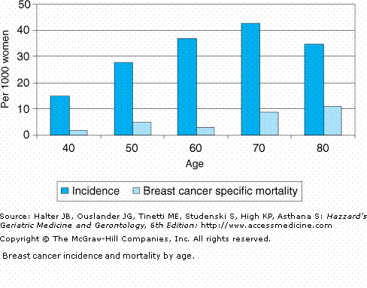
Breast Cancer Incidence and Mortality by Age

Slide 30
Preoperative Assessment of Cancer in the Elderly (PACE)
Pilot Study published in 2003 in Supportive Cancer Therapy.
Instruments included:
    MMSE
    ADLs
    IADLs
    GDS
    Brief Fatigue Inventory
    ECOG Performance Status
    American Society of Anesthesiologists (ASA) Physical Status Scale
    Satariano’s Index of Comorbidities
PACE participants, Audisio, R.A., Pope, D., et al. Shall we operate? Preoperative Assessment of Cancer in the Elderly (PACE) can help.
A SIOG surgical task force prospective study. Crit Rev Oncol Hematol. 2008 Feb 65(2): 156-63.

Slide 31
Preoperative Assessment
Having one dependent IADL, abnormal presenting symptoms, or moderate/severe blood flow index increased the patient’s likelihood of have any surgical complication by 50%.

Slide 32
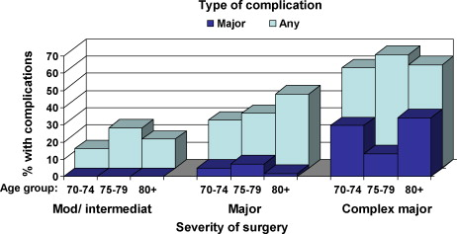
Preoperative Assessment
Notes:
There was no significant relationship between age and
complications (p > 0.05). As one would expect, there was a
significant relationship between complications and severity
of surgery, irrespective of age (Fig. 1).

Slide 33
CGA and the Surgical Patient
This patient had a major surgery with subsequent complications and a very difficult post operative course.
Follow-up visits with the patient in the Palliative Clinic determined that her delirium did resolve eventually and the patient was bedbound and completely dependent for care.
She was ultimately placed on home hospice.

Slide 34
CGA and the Vulnerable Patient
Investigating cases of suspected elder abuse can be a daunting task for all involved.
Requires a multidisciplinary approach to the patient including local Adult Protective Services authorities, the judicial system and the geriatric team.
The work of the medical case management team generally occurs in three phases
Investigation or assessment made by the referring agency
Comprehensive Geriatric Assessment done by the medical team led by the Geriatrician
Interprofessional Team Meeting to develop a joint intervention plan

Slide 35
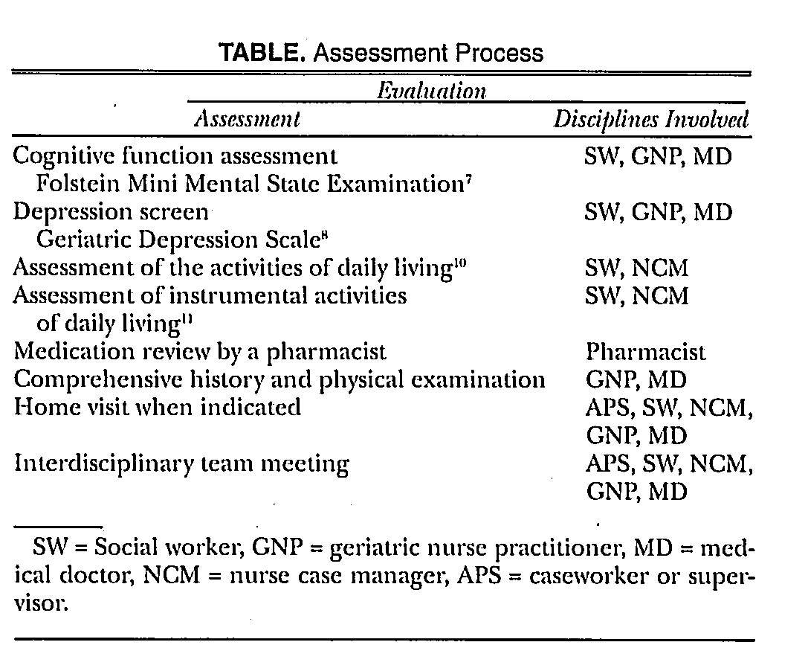
Notes:
Assessment Process of the Vulnerable Geriatric Patient

Slide 36
CGA and the Hospitalized Patient
Used in ACE (Acute Care of the Elderly) units.
Provided as a part of a Geriatric consult.
No study is worth more value than the appreciation from other disciplines, the kind words from families and the joy on a patient’s face seen when you say. . .
“ I am trained to take care of YOU and your friends!”

Slide 37
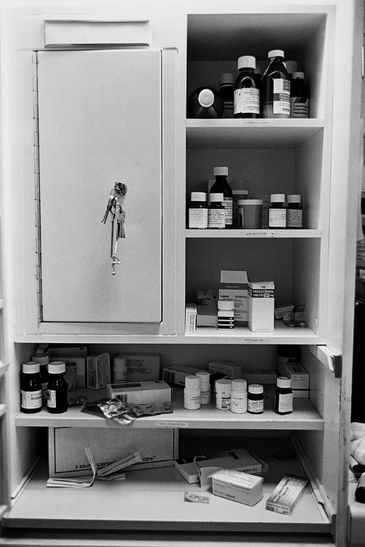
Polypharmacy
Defined as greater than four prescription medications or greater than three new medications in a 24-hour period.
Four or more prescription medications increases the risk for falls in the elderly.
Five or more prescription medications increases the risk of adverse drug reactions.
30% of older adult hospital admissions can be
linked to drug-related effects, and polypharmacy
is the fifth leading cause of death for
hospitalized elders.

Slide 38
Aging and Medication Metabolism
Liver
    Decline in the Cytochrome P450 system
Renal
    Decrease in Glomerular Filtration Rate
    Decrease in tubular function
    Decreased creatinine clearance
  Increased serum levels
  Increased half life

Slide 39
Polypharmacy Signs and Symptoms
Dry mouth
Tachycardia
Confusion
Diarrhea
Constipation
Peripheral edema
Extra pyramidal side effects
Syncope
Orthostatic hypotension
Hypoglycemia
Congestive heart failure/pulmonary edema
Flatulence
Bloating
Somnolence
Lethargy

Slide 40
Factors Associated With Polypharmacy
Patient Factors:
Older age
Female
Low education level
Rural living
Multiple chronic illnesses
Use of multiple medications
Having multiple pharmacies dispense medications
System Factors:
Many different prescribers
Poor patient record keeping
Failure to review patient’s medications at regular intervals and post hospitalization

Slide 41
Principles for Prescribing for Older Adults
Is the medication necessary?
Do the benefits outweigh the risks?
What are the desired therapeutic effects and how will they be measured?
What are the potential drug-drug interactions?
Try to start only one new medication at a time.
Titrate the dose slowly as tolerated by the patient.
Start with a low dose.
Identify and explain the indications and the directions to the patient and the caregiver.
Identify and stop any duplicate medications.

Slide 42
Management
Pharmacologic
Non-pharmacologic
Medication review
    At every office visit
    After every hospitalization
Eliminate medications with duplicate effects
Stop medications that are ineffective or have sub-optimal therapeutic effects
Add new medications one at a time
Use the advice “start low and go slow” for starting new medications
Know all non-prescription medications, supplements, and herbal supplements.
Write out schedules
Write out indications for each medication
Use pill boxes to track adherence
Detailed explanations of each medication and the indication increase adherence

Slide 43
Comprehensive History and Physical Exam
History Taking and the Older Patient
Vitals
      Orthostatics
Listen to the patient and caregivers!
Physical Exam
Older patients tend to overestimate their health or underreport their symptoms
    Accidentally or purposefully
    Consider most of their symptoms as normal aging
    Embarrassed and see symptoms as loss of virility/power
    Simply forget!

Slide 44
History Taking and the Older Patient
COLDEST
History of Present Illness
  Pain
        Acute vs. Persistent
              Character,
              Onset,
              Location,
              Duration,
              Exacerbating Factors,
              Strength,
              Timing
    Other co-morbidities
    Does it fit with other geriatric syndromes?

Slide 45
History Taking and the Older Patient
Geriatric Syndromes
  Dementia- “Do you feel like you have a problem with memory?”
  Delirium- “Have you noticed a sudden change in behavior or confusion?”
  Falls- “Have you had any falls recently” or “Do you fall frequently?”
  Urinary Incontinence- “Are you able to make it to the bathroom without any accidents”
  Depression- “Are you depressed?”
  Malnutrition- “How’s your appetite?” or “Do you feel hungry?” or “How do you get your meals everyday?”
  Insomnia- “Do you have difficulty with sleep?”

Slide 46

Depression
“Why are
older people
so sad?”

Slide 47
Prevalence of Depression
Community
      2% major, 10-30% depressive symptoms
Outpatient
      5-10%, 10-30%
Inpatient
      10-20%, 10-30%
Long Term Care Setting
      10%, 30%

Slide 48
Isn’t it an outpatient issue? / Why screen in the hospital?
Up to one-half of all depressed elderly seen by a primary care physician are not identified as depressed.
Depressive symptoms in hospitalized elders can increase risk of:
      Readmission
      Functional Decline
      Mortality

Slide 49
Depression in the Hospitalized Patient- Why Screen?
Can increase length of stay because it slows recovery and mobilization
Inpatient is a good time to make a diagnosis and get referrals in place
Treatments are effective

Slide 50
Who is at Risk?
Female Gender
Divorced or separated status
Low socioeconomic status
Poor social support
Comorbid illness
Cognitive impairment
Adverse/Stressful life events
Family history
Prior depressive episodes
Previous suicide attempts
Financial stress

Slide 51

Associated Medical Problems
Dementia
Diabetes Mellitus
Rheumatoid Arthritis
History of Cerebro-Vascular Accident
Myocardial Infarction
Cancer
Parkinson’s Disease

Slide 52
Atypical Presentation
Older depressed patient often has different complaints and presentations than younger patients
Less commonly experience “mood symptoms”
Older patients often have more somatic symptoms and may end up hospitalized

Slide 53
Depression in Older Adults: What else to look for?
Irritability, anxiety or decreased functional status
Recognize that the role of co-existing medical problems, cognitive deficits, multiple medications complicates the picture
Many assume depression is a normal part of aging

Slide 54
Who Should be Screened?
Patients with commonly associated medical problems
Adverse life events
Physical signs and symptoms: pain, insomnia, fatigue and weight loss
Screening for Depression
Geriatric Depression Scale:
      15 point question scale
      92% sensitivity and 89% specificity
Just ask, “Are you depressed?”

Slide 55
Medications that can Cause Depression
Antihypertensives
      Beta Blockers
      Clonidine
Anti Parkinson’s Medications
      Carbidopa/Levodopa
Others
      Benzodiazepines
      Antihistamines
      Barbituates

Slide 56
Treatment: Medications
Selective Serotonin Reuptake Inhibitors (SSRIs) are somewhat interchangeable regarding effectiveness.
Choose an SSRI based on side effect profile, drug interactions and compliance.
Citalopram and Sertraline are often recommended among experts for efficacy and tolerability in the elderly.
Paxil: Anticholinergic properties

Slide 57

Treatment: Therapy
Cognitive Behavioral Therapy and Interpersonal Therapy
In the outpatient setting, medications and brief psychotherapy have been shown to be more effective than usual care.

Slide 58
Insomnia
Difficulty in initiating or maintaining sleep
NOT excessive daytime sleepiness
      Usually due to a primary sleep disorder (sleep apnea, narcolepsy, periodic limb movement disorder)
Most commonly due to
      Psychiatric illness
      Pyschophysiologic problems
      Drug or Alcohol Dependence
      Restless Leg Syndrome

Slide 59
Treatment for Insomnia
Alter the environment to make it less disturbing at night . . . minimize night time lighting, sounds and procedures (labs and vitals) and make the bed comfortable (the fewer restraints the better).
Make sure the patient is active (not napping) during the day with physical therapy, family, and volunteers to help keep the patient company.
Evaluate the medications and make sure the patient’s pain is well controlled.
Warm milk/tea, relaxing music/white sound, and massages can be helpful.
Safer medications for the geriatric population include low dose Trazodone or Mirtazapine.

